Slide 1
Topic: The order of operations
EQ :How do I add and subtract integers?
Get your VIVOS
- Number Ninja???????

Slide 2
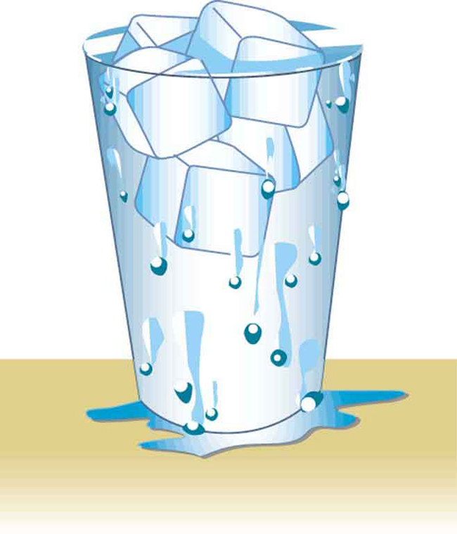
24
7
30
Date
The order of operations
EQ – How do I add and subtract integers?
3 MINS TO Write down and have an answer to share with shoulder partner
Hot and cold
2 + 3 =
2+(-3) =
2 – 3 =
2 – (-3) =

Slide 3


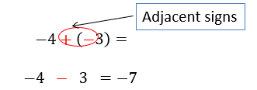
24
7
30
Date
The order of operations
EQ – How do I add and subtract integers?
Replace two adjacent signs using the following rules
What are the rules for adding and subtracting integers?
Example:

Slide 4
24
7
30
Date
The order of operations
EQ – How do I add and subtract integers?
Wow!!!!!! That concept was a big step from Year 7.
This video may help you as well as our work on number lines last lesson
Little chicken:
https://www.youtube.com/watch?v=DBSviXhkubg
The first operation tells us what end of the number line to face ( + face the positive end of number line) ( - face the negative end of number line)
The second operation and number tells us how far to move and in what direction (forward if it is positive and backwards if it is negative)

Slide 5
24
7
30
Date
The order of operations
EQ – How do I add and subtract integers?
Practice time using your LHS:
Adding integers worksheet
Subtracting integers worksheet
Adding and subtracting integers with solutions worksheet

